Slide 1

Rechnerarchitekturen für Deep-Learning Anwendungen (RADL)
Dustin Heither, Maximilian Achenbach, and Robert Kagan
Optimizing Deep Learning Performance:
A Hybrid CPU-GPU Framework with Multithreading, SIMD,
and Evaluation of Efficiency Metrics

Slide 2
Outline
4. Presentation
01
Tweaks & Enhancements
02
Hardware & Benchmark
03
CUDA Tuning
04
SIMD
05
Outlook

Slide 3
Tweaks & Enhancements
1 / 2
Inlining
Goal: Minimize overhead caused by function calls
Solution: Inlined all utility functions
Data Type Flexibility
Goal: Enable the use of integers when working with quantized weights
Solution: Began implementing support for diverse data types
Smart Multithreading Implementation
Goal: Mitigate unnecessary synchronization overhead
Solution: Applied multithreading only under significant load
__attribute__((always_inline)) inline int get_idx(int i, int j, int y);
#ifndef DATA_TYPE
#ifdef INT
typedef int DATA_TYPE;
#else
typedef float DATA_TYPE;
#endif
#endif
typedef struct matrix {
int x;
int y;
DATA_TYPE *m;
} matrix;
if(THREADS > c->y) {
single_core = 1;
}

Slide 4

Tweaks & Enhancements
2 / 2
Implemented make config for a user-friendly option selection

Slide 5
Hardware & Benchmark
Hardware Overview
CPU | Release date | TDP (W) | Number of (performance) cores | Number of threads
AMD Ryzen 7 3800XT | 7. Juli 2020 | 105 | 8 | 16
Apple M3 Pro 11-Core | 30. Oktober 2023 | 27 | 5 | 11
Intel Core i7 1065G7 | 1. Juni 2019 | 15 | 4 | 8
GPU | Release date | TDP (W) | Number of CUDA cores | Base Clock (MHz)
NVIDIA GeForce RTX 2080 | 20. September 2018 | 215 | 2944 | 1515
NVIDIA GeForce MX350 | 10. February 2020 | 20 | 640 | 1354

Slide 6
Hardware & Benchmark
Benchmark Overview
Batch size: 1
Epochs: 128
ICPX:
In microseconds (µs)
Averaged over 10 runs
Intel oneAPI C++ Compiler
Old:
In microseconds (µs)
Averaged over 10 runs
Total time (last presentation)
XL:
In microseconds (µs)
Averaged over 10 runs
Image dimensions of (32x30)²

Slide 7
CUDA Tuning
1 / 2
Finalized CUDA Implementation
Change: Adjusted maxpool output dimensions to ensure compatibility with CUDA kernels
Benefit: Implemented the last missing function
matrix *flatten(matrix *a, int len, matrix *c);
Increased CUDA Thread Count
Optimized utilization of the massive parallelism offered by GPU cores
GPU Memory Management
Enabled main function to allocate matrices directly in GPU memory
IO Matrices Copied To GPU In Main Function
Moved allocations outside the main loop to enhance performance and centralization

Slide 8
CUDA Tuning
2 / 2
Performance Bottlenecks
Frequent use of cudaMalloc and cudaMemcpy for calculation matrices
Significant overhead impacts overall performance
Proposed Improvements
Further centralize memory allocation
Eliminate memory transfer overhead during calculations

Slide 9
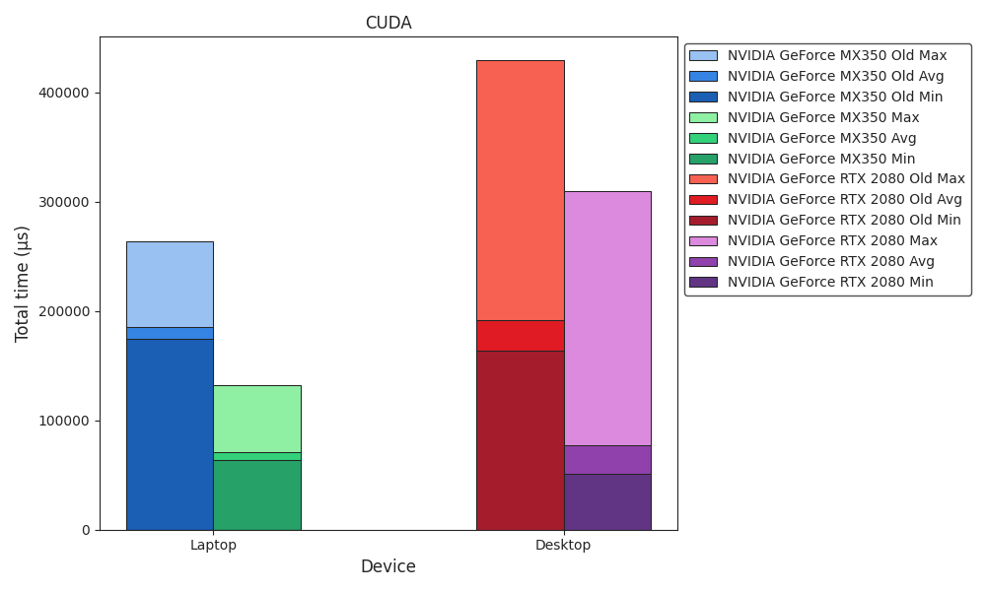
Benchmark
CUDA

Slide 10
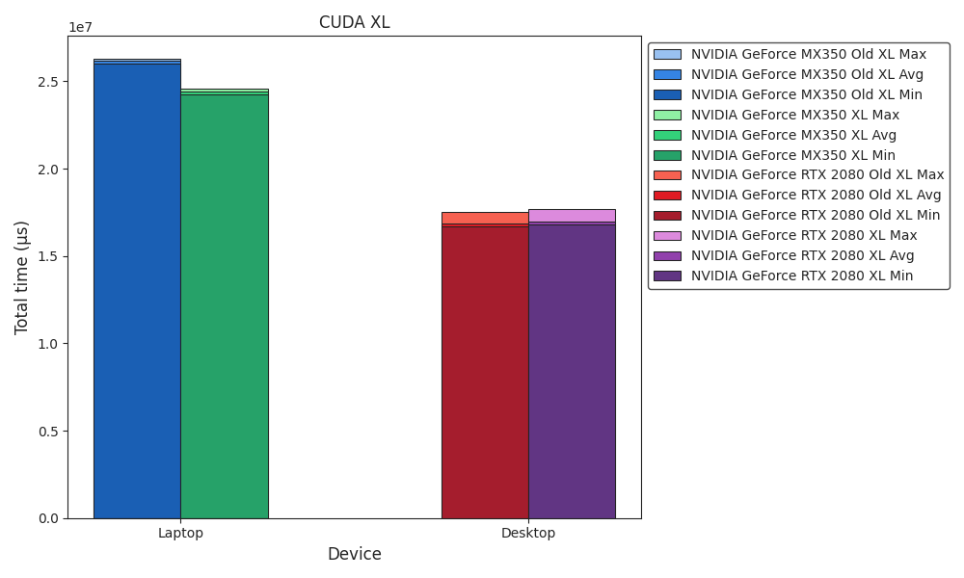
Benchmark
CUDA XL

Slide 11
SIMD
ARM
Progress
Added support for AMX
Implemented void matmul_simd(mt_arg *mt); using AMX
Apple AMX Instruction Set
Integrated into Apple Silicon
Specialized matrix multiplication engine
Optimized for AI and ML tasks
Benefits
Accelerates matrix-heavy operations
Improves performance
Type flexibility (floats and integers)
Challenges
Reverse Engineering:
Relying on a personal GitHub repository
Lack Of Documentation:
Difficult implementation
Difficult troubleshooting

Slide 12
SIMD
x86
Inlined SIMD
Change: Inlined all SIMD functions
Benefit: Minimize function calls and reduce overhead
Transposed Inputs
Reordered data for improved memory access efficiency
AVX-512 Implementation
Added support to process 16 values at a time (instead of 4)
Added padding to ensure parallel processing, even when insufficient data is available
AVX2 Fallback
Added AVX2 fallback for systems lacking AVX-512 support
Checks AVX-512 support at runtime for compatibility
__attribute__((always_inline)) inline void matmul_simd(mt_arg *mt) {
#ifdef x86
if(is_avx512_supported()) {
long CHUNK_SIZE = sizeof(__m512) / sizeof(DATA_TYPE);
__m512 a, b;
__mmask16 m;
for(int k = 0; k < mt->a->y; k += CHUNK_SIZE) {
m = (__mmask16)((1 << (((k + CHUNK_SIZE) <= mt->a->y) ? CHUNK_SIZE : mt->a->y - k)) - 1);
a = _mm512_maskz_loadu_ps(m, &mt->a->m[get_idx(mt->i, k, mt->a->y)]);
b = _mm512_maskz_loadu_ps(m, &mt->b->m[get_idx(mt->j, k, mt->b->y)]);
mt->c->m[get_idx(mt->i, mt->j, mt->c->y)] += _mm512_reduce_add_ps(_mm512_mul_ps(a, b));
}
}
#endif
}

Slide 13
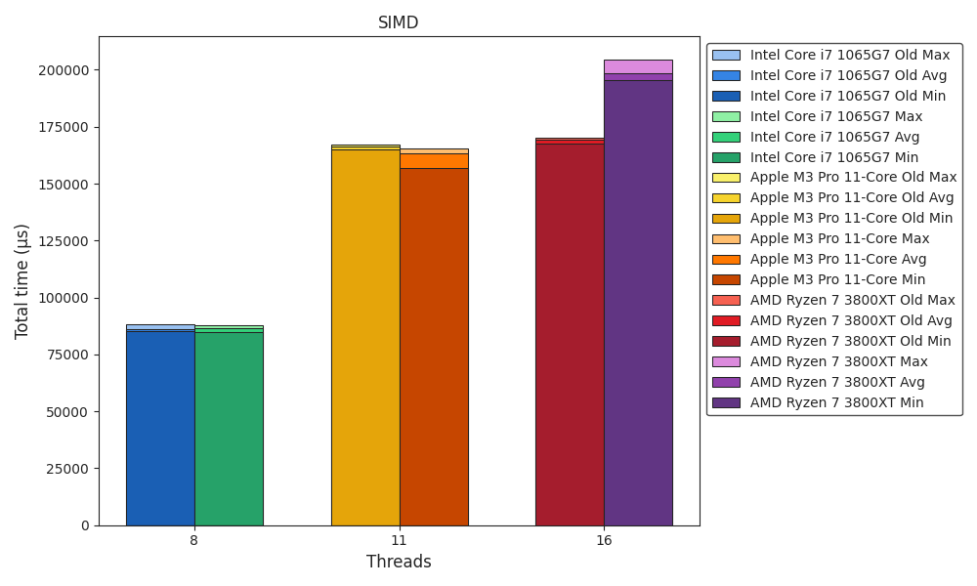
Benchmark
SIMD

Slide 14
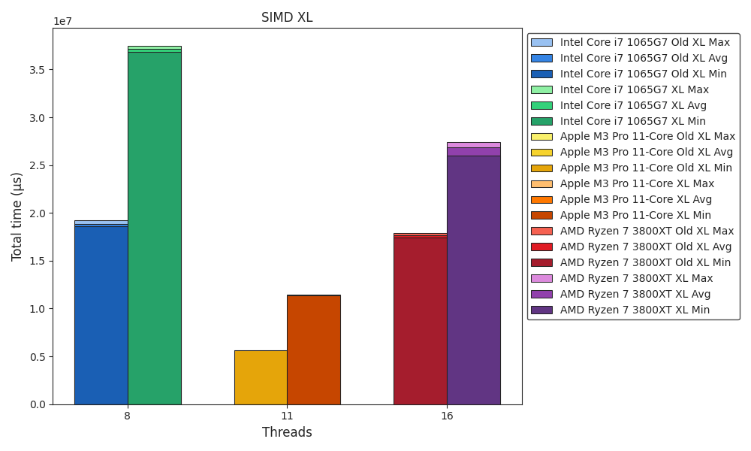
Benchmark
SIMD XL

Slide 15
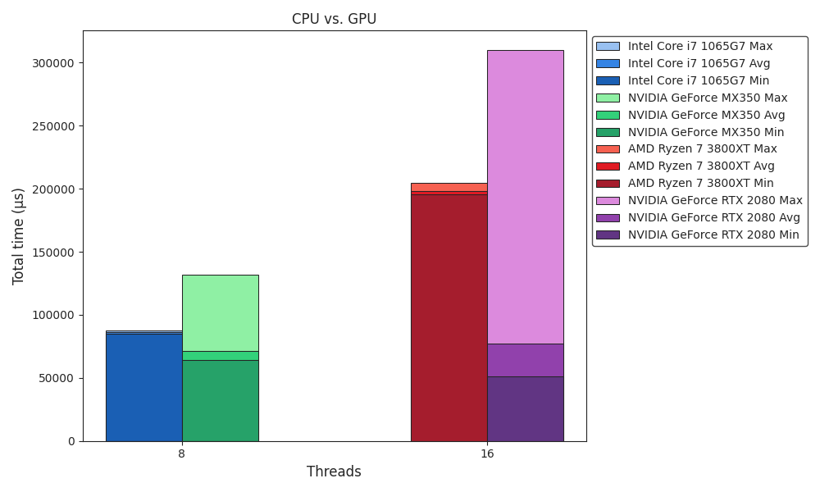
Benchmark
CPU vs. GPU

Slide 16
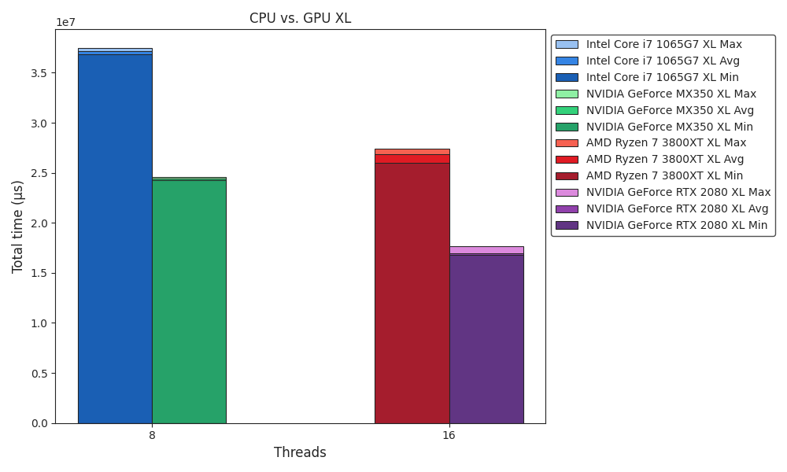
Benchmark
CPU vs. GPU XL

Slide 17
Outlook
Work In Progress
Framework ✅
ICPX vs. Clang ✅
CUDA Tuning ✅
Eliminate memory transfer overhead (WIP)
Multithreading ✅
(OpenMP GPU offload target)
SIMD ✅
Apple AMX Instruction Set (WIP)
Quantization 🚧
Prepare SIMD for integers (WIP)
(Apple M3 Pro NPU)

